Slide 1
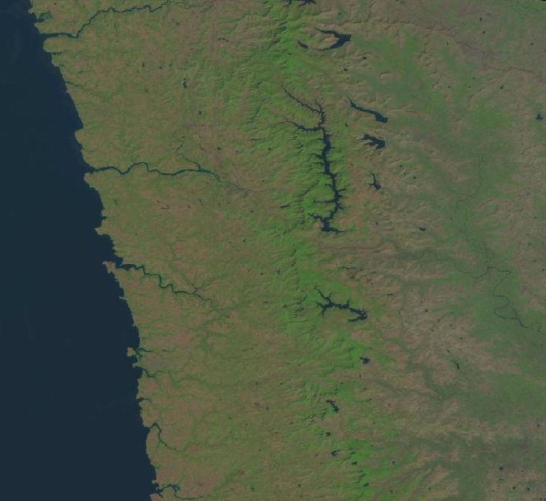
Vision Based Satellite Imagery For Riparian And Forest Ecosystem (CV CP PID- 34)
Vishwakarma Institute of Technology, Pune
CV Seminar
Computer Vision – TY D 2023
Authors:
Prof. Jyoti Madake, Swapnil Patil, Devyani Ushir
Department of E&TC Engineering

Slide 2
Introduction
Literature Survey
Novelty
Methodology
Results
Advantages and Limitations
Conclusion
Contents

Slide 3
INTRODUCTION:
Manual classification of ecosystems using satellite imagery is prone to accuracy issues, leading to incorrect identification.
Analyze riparian & forest Ecosystem change, over a 10-year period.
By using Computer Vision Approach.
Total area of vegetation and perimeter calculated for identified ecosystem analysis.
Notes:
Remote sensing techniques, especially vision-based satellite imagery, can provide an effective and efficient way to monitor the health of these ecosystems and detect changes over time. This technique involves analyzing satellite images to identify and classify different features of these ecosystems such as vegetation cover, land use, and water bodies. The use of vision-based satellite imagery for riparian and forest ecosystem classification can provide valuable information to support informed decision-making for their management and conservation.
However, this technique also faces several challenges, such as the complexity of ecological features in these ecosystems, the variability in satellite image quality, and the need for large-scale data processing and analysis. Therefore, there is a need to develop accurate and reliable methods to identify and classify riparian and forest ecosystems using satellite imagery, which can support the development of sustainable land-use practices and mitigate the impacts of human activities on these ecosystems.

Slide 4
LITERATURE SURVEY

Slide 5
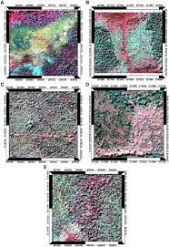
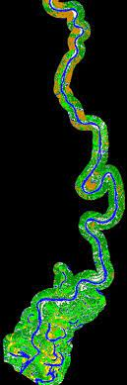
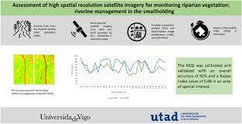
Riparian and forest ecosystem classification
[1]
Terrestrial Ecosystem Mapping [TEM] For Vegetation calculation.
Results showed that window sizes of 3×3 pixels and 11×11 pixels were most appropriate for image texture calculations
Satellite Imagery For Monitoring Vegetation
[2]
RSQI tool for Monitoring Riparian, With Accuracy of 92% and a kappa index value of 0.88.
Uses High Resolution satellite Imagery
Satellite-based analysis of classification algorithms [3]
Classification of satellite images Using ML,DT,NN.
Random forest Algorithm Provided the Highest accuracy and kappa coefficient.

Slide 6
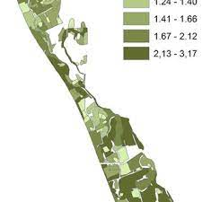
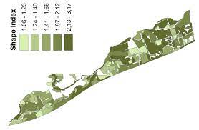
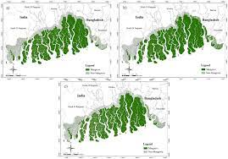
Object-based class modeling for riparian
[4]
workflow-based strategy for automated habitat delineation and assessment, using a hierarchical class modeling scheme and 8-band WorldView-2 imagery.
Remote sensing for satellite images
[5]
Used Classification Techniques Such as object oriented Classification and Supervised-Unsupervised Classification.
segmentation of images into its land cover type.
Mangrove mapping using satellite imagery
[6]
Mangrove forests provide valuable ecosystem services such as coastal erosion protection, water filtration and shelters.
Used Normal Difference Vegetation Index.

Slide 7
Research Gap :
Unable to give Good results for low Resolution images
Insufficient investigation of image Variability effects
Inadequate research on how to account for temporal changes.
Limited Approaches Using Computer Vision
Notes:
Remote sensing techniques, especially vision-based satellite imagery, can provide an effective and efficient way to monitor the health of these ecosystems and detect changes over time. This technique involves analyzing satellite images to identify and classify different features of these ecosystems such as vegetation cover, land use, and water bodies. The use of vision-based satellite imagery for riparian and forest ecosystem classification can provide valuable information to support informed decision-making for their management and conservation.
However, this technique also faces several challenges, such as the complexity of ecological features in these ecosystems, the variability in satellite image quality, and the need for large-scale data processing and analysis. Therefore, there is a need to develop accurate and reliable methods to identify and classify riparian and forest ecosystems using satellite imagery, which can support the development of sustainable land-use practices and mitigate the impacts of human activities on these ecosystems.

Slide 8
Novelty :
Utilization of Color Based Segmentation
Integration of temporal data
Use of USGS dataset
Improved Results
Notes:
Remote sensing techniques, especially vision-based satellite imagery, can provide an effective and efficient way to monitor the health of these ecosystems and detect changes over time. This technique involves analyzing satellite images to identify and classify different features of these ecosystems such as vegetation cover, land use, and water bodies. The use of vision-based satellite imagery for riparian and forest ecosystem classification can provide valuable information to support informed decision-making for their management and conservation.
However, this technique also faces several challenges, such as the complexity of ecological features in these ecosystems, the variability in satellite image quality, and the need for large-scale data processing and analysis. Therefore, there is a need to develop accurate and reliable methods to identify and classify riparian and forest ecosystems using satellite imagery, which can support the development of sustainable land-use practices and mitigate the impacts of human activities on these ecosystems.

Slide 9
METHODOLOGY

Slide 10
Block Diagram :
USGS Dataset
1.Riprian
2.Forest
Preprocessing
Segmentation
Riparian And Forest Area Analysis
Riparian And Forest Ecosystem Classification

Slide 11
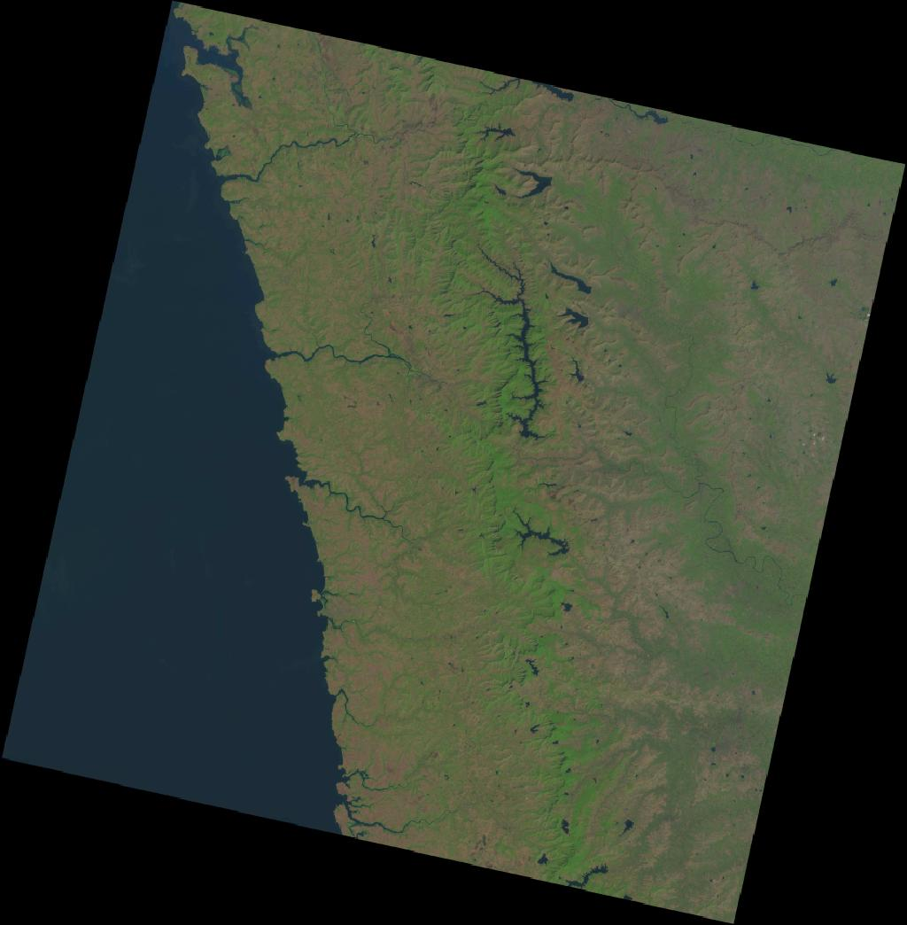
Dataset Collection :
High Resolution Images (1024 * 1044)
USGS Dataset
Dataset Consist of 10 Images From
Year [2014-2023]
1. Riparian 2. Forest
Location- Koyna Wildlife Sanctuary for (Riparian)
Tadoba Andhari for (Forest)
Landsat-8 Images
Fig.1. Dataset Creation
Notes:
We have gathered the necessary satellite Images for the riparian and forest areas. As a data collection is a crucial part of the project. For that, we have chosen the Tadoba andhari region for the forest and the Konya Wildlife Sanctuary for riparian areas. On the USGS Earth Explorer, we have compiled all of the satellite images from the past 10 years, from 2014 to 2023. We have selected a high-resolution (1024*1044) landsat-8 image.

Slide 12
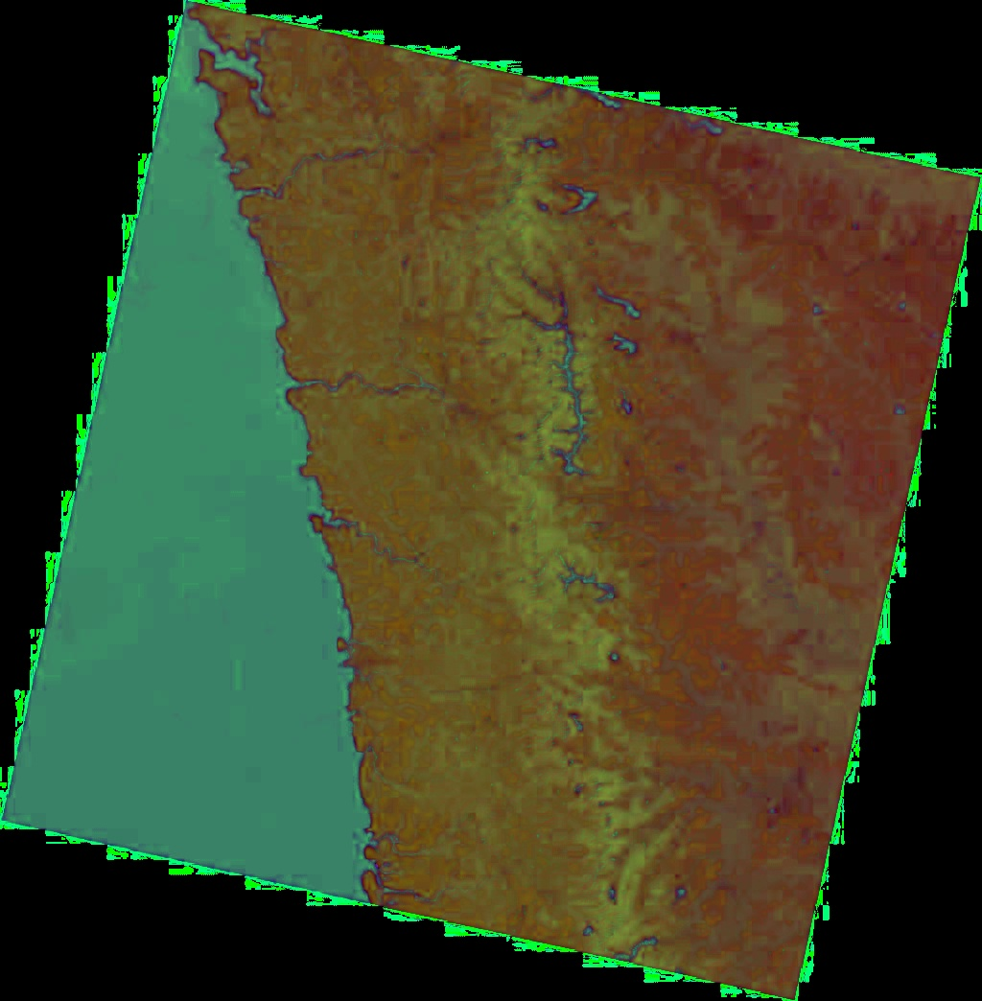
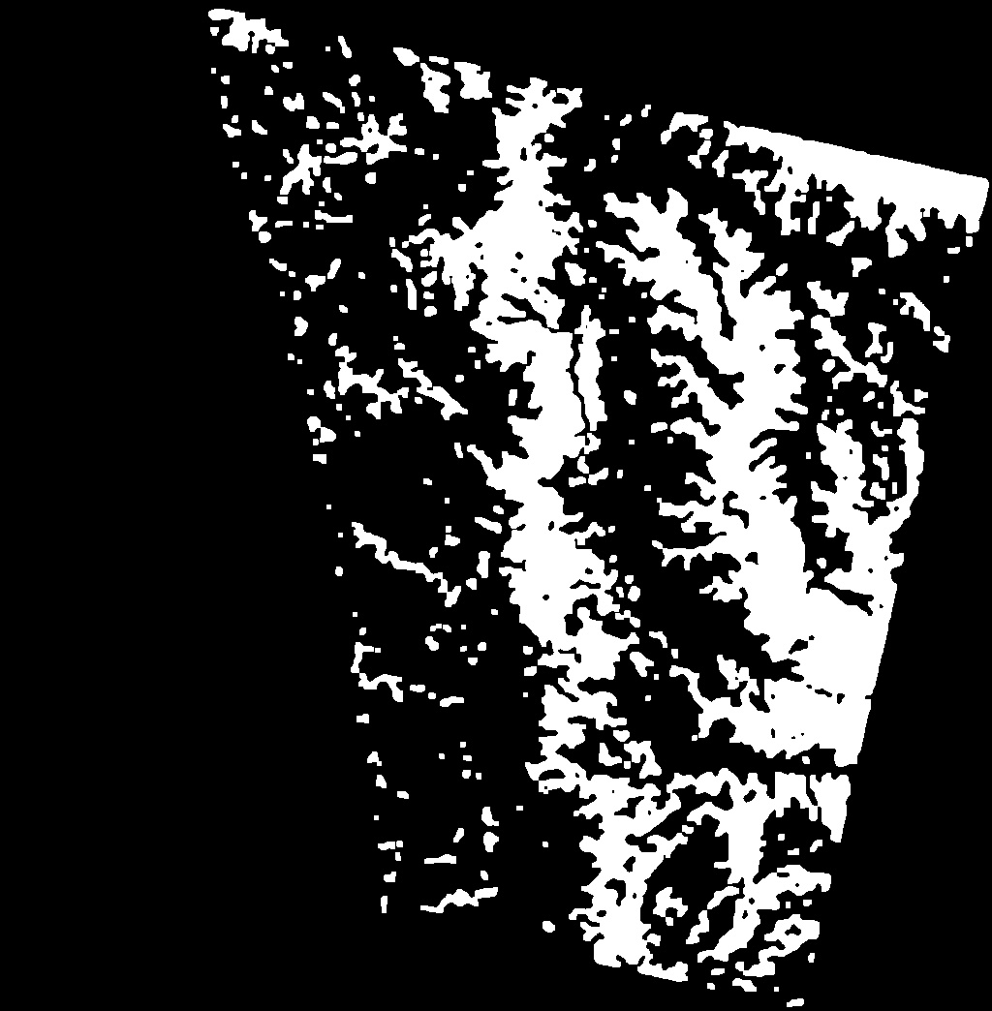
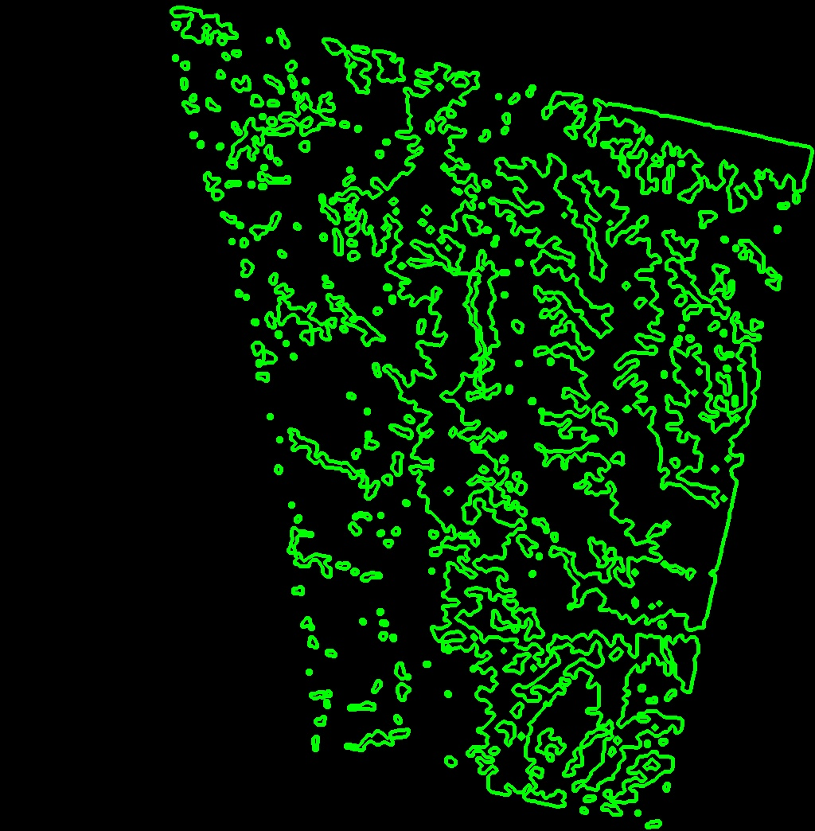
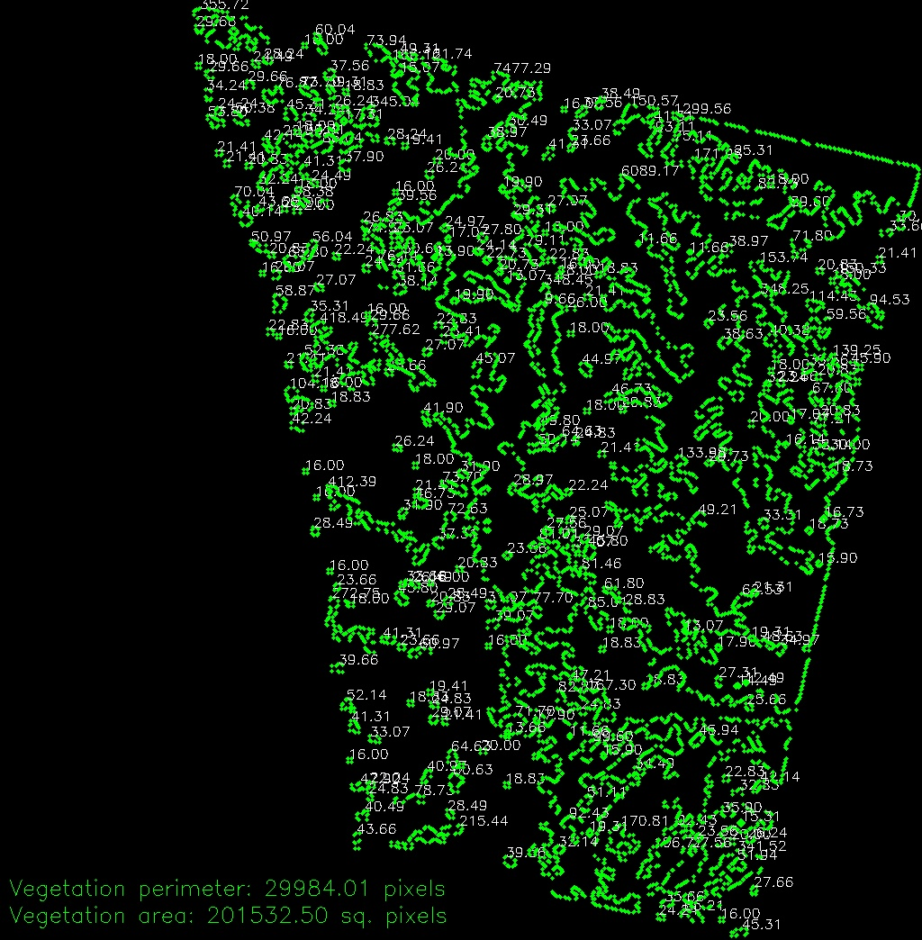
Functional Diagram :
Dataset
Convert to HSV
Thresholding
Morphological Operation
Contours
Color-based segmentation
lower_green = (40, 40, 40)
upper_green = (70, 255, 255)
Notes:
Here is the flow diagram of our proposed system so we have convert our images to HSV (hue, saturation, value) It is a color space that represents colors based on these three dimensions. Hue represents the color itself, such as red, blue, green, etc. Saturation represents the intensity or purity of the color, and value represents the brightness of color Then next we have set a threshold for lower and upper bound 40 40 40 for lower green and 70 255 255 for upper green then we have performed morphological operation. Morphological operations are often performed on binary images, The main purpose of the morphological opening operation is to remove small or isolated areas in the binary mask next we have drawing the contours of the vegetation zone to evaluate the vegetation area then we have done a segmentation . A method used in image processing to separate objects or regions according to their color or hue is called color-based segmentation this way we have find a final result of segmentation and calculation of its area and perimeter for analyzing the changes.

Slide 13
Features For The Segmented Region :
Area = Total_Area * (Num_Segmented_Pixels / Total_Num_Pixels)
Perimeter = Total_Perimeter * (Num_Segmented_Pixels / Total_Num_Pixels)

Slide 14
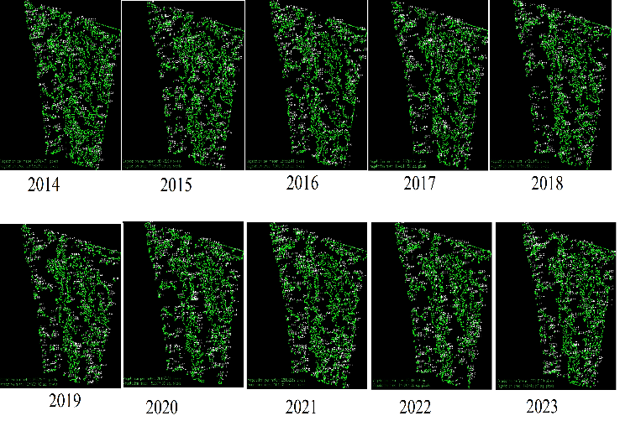
Riparian Vegetation Results :

Slide 15
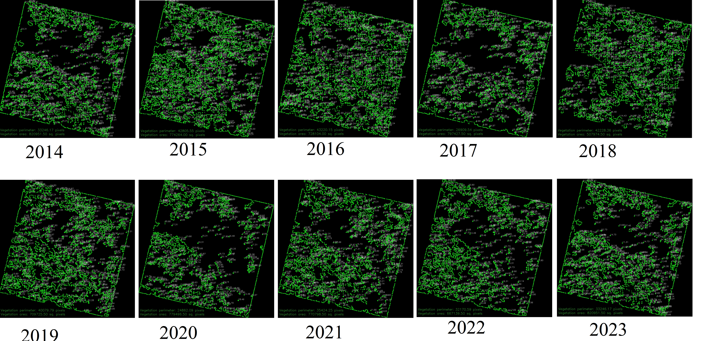
Forest Vegetation Results :

Slide 16
Results :
TABLE I. VEGETATION AREA AND PERIMETER OF RIPARIAN AREA
TABLE II. VEGETATION AREA AND PERIMETER OF FOREST AREA
Sr. No | Year | Area | Perimeter
1. | 2014 | 201532.50 sq. pixel | 29984.01 pixel
2. | 2015 | 173149.00 sq. pixel | 26796.90 pixel
3. | 2016 | 150078.50 sq. pixel | 25532.41 pixel
4. | 2017 | 164911.50 sq. pixel | 26784.61 pixel
5. | 2018 | 145998.00 sq. pixel | 24200.95 pixel
6. | 2019 | 133833.00 sq. pixel | 22879.41 pixel
7. | 2020 | 152577.00 sq. pixel | 26163.81 pixel
8. | 2021 | 164505.50 sq. pixel | 28152.82 pixel
9. | 2022 | 144204.00 sq. pixel | 25460.58 pixel
10. | 2023 | 140745.50 sq. pixel | 25915.29 pixel
Sr. No | Year | Area | Perimeter
1. | 2014 | 763685.50 sq. pixel | 34665.03 pixel
2. | 2015 | 774264.00 sq. pixel | 42805.55 pixel
3. | 2016 | 728104.00 sq. pixel | 43220.15 pixel
4. | 2017 | 797427.50 sq. pixel | 26909.54 pixel
5. | 2018 | 507974.50 sq. pixel | 42228.36 pixel
6. | 2019 | 709725.50 sq. pixel | 40079.79 pixel
7. | 2020 | 779496.50 sq. pixel | 24862.09 pixel
8. | 2021 | 770798.50 sq. pixel | 35424.25 pixel
9. | 2022 | 667139.50 sq. pixel | 32170.59 pixel
10. | 2023 | 820951.50 sq. pixel | 33246.17 pixel

Slide 17
Advantages
Limitations
Able to classify changes in ecosystem.
Gives Improved Results
Portable & Lightweight system
Cost effective
Noisy input images can leads to wrong prediction.
Cloud Image Can Not Predict

Slide 18
Conclusion :
Gives User Understanding about the Riparian and Forest Ecosystem.
Can Accurately gives the Ecosystem Changes.
System can give Sharpened Result for High Resolution satellite Imagery.
Efficient and Cost-Effective Solution
Notes:
Remote sensing techniques, especially vision-based satellite imagery, can provide an effective and efficient way to monitor the health of these ecosystems and detect changes over time. This technique involves analyzing satellite images to identify and classify different features of these ecosystems such as vegetation cover, land use, and water bodies. The use of vision-based satellite imagery for riparian and forest ecosystem classification can provide valuable information to support informed decision-making for their management and conservation.
However, this technique also faces several challenges, such as the complexity of ecological features in these ecosystems, the variability in satellite image quality, and the need for large-scale data processing and analysis. Therefore, there is a need to develop accurate and reliable methods to identify and classify riparian and forest ecosystems using satellite imagery, which can support the development of sustainable land-use practices and mitigate the impacts of human activities on these ecosystems.

Slide 19
References:
Johansen, Kasper, Nicholas C. Coops, Sarah E. Gergel, and Yulia Stange. "Application of high spatial resolution satellite imagery for riparian and forest ecosystem classification." Remote sensing of Environment 110, no. 1 (2007): 29-44.
Rivas-Fandiño, Paula, Carolina Acuña-Alonso, Ana Novo, Fernando António Leal Pacheco, and Xana Álvarez. "Assessment of high spatial resolution satellite imagery for monitoring riparian vegetation: riverine management in the smallholding." Environmental Monitoring and Assessment 195, no. 1 (2023): 81.
Salovaara, Kati J., Sirpa Thessler, Riffat N. Malik, and Hanna Tuomisto. "Classification of Amazonian primary rain forest vegetation using Landsat ETM+ satellite imagery." Remote Sensing of Environment 97, no. 1 (2005): 39-51.
Bekkari, Aissam, S. Idbraim, K. Housni, Driss Mammass, and Youssef Chahir. "Classification of high-resolution urban satellite Images combining SVM and Graph Cuts." In 2010 5th International Symposium On I/V Communications and Mobile Network, pp. 1-4. IEEE, 2010.
Tarasova, L. V., and L. N. Smirnova. "Satellite-based analysis of classification algorithms applied to the riparian zone of the Malaya Kokshaga river." In IOP Conference Series: Earth and Environmental Science, vol. 932, no. 1, p. 012012. IOP Publishing, 2021.
Strasser, Thomas, Stefan Lang, L. Pernkopf, and K. Paccagnel. "Object-based class modeling for assessing habitat quality in riparian forests." Proceedings of GEOBIA (2012): 555-560.

Slide 20
THANK YOU

